Slide 1
Predicting Compound-Protein Interactions From Statistical Learning Perspective
PhD Candidate: Songpeng Zu
Advisor: Prof. Shao Li
2015-09-01

Slide 2
Content
Introduction on Compound-Protein Interactions (CPIs)
Prediction on CPIs from Statistical Learning.
Inference on the latent features from CPIs by EM algorithm
Quantitative prediction on CPIs by multi-task learning
Graph partition based prediction on CPIs
Application
Predicting RIP3 inhibitors
Ginkgolide’s bioactivity study
Summary

Slide 3
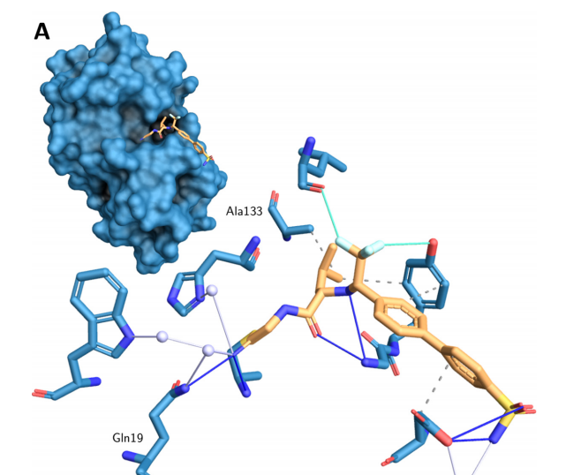
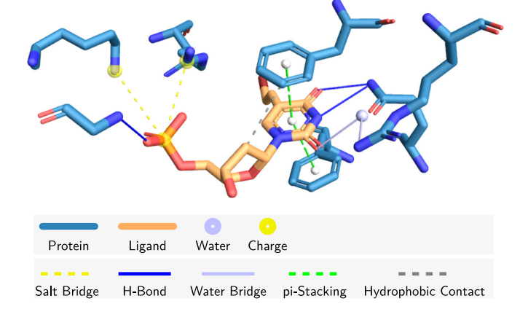
Compound-Protein Interactions
Interactions
Binding Modes
Protein
Compound
Amino Acid residues
How can we predict the interactions and binding modes ?
Salentin, S., et al., PLIP: fully automated protein–ligand interaction profiler. Nucleic Acids Res. 2015 43: W443-W447.

Slide 4
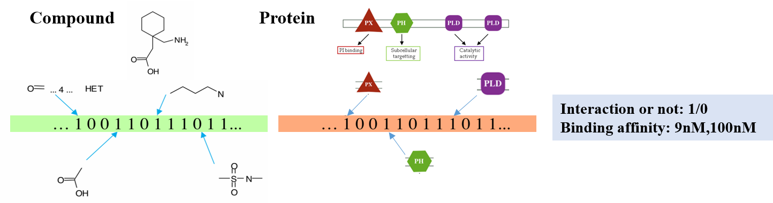
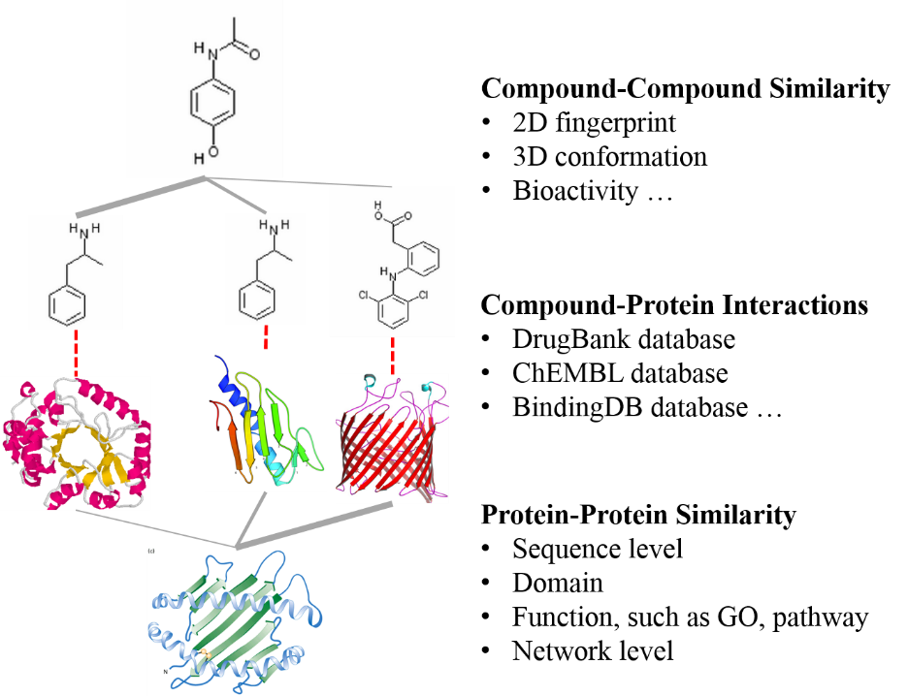
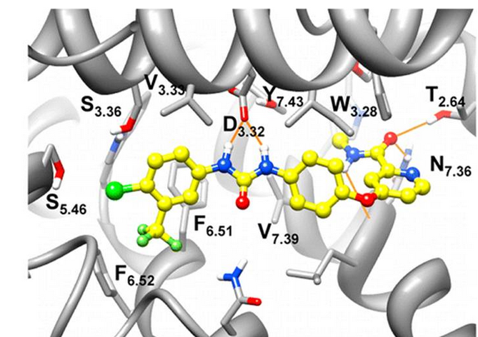
Mathematical Models
Chemoinformatics
Similarity Network
Molecular Dynamics

Slide 5
Mathematical Models
Statistical Learning
Chemistry-based simulation
Similarity-based network
Chemoinformatics
Molecular dynamics
Independent with protein structures
Based on the large-scale accumulated data
Miss the detailed binding information
Show with much detailed information
Ignore previous data
Lack of protein structures, especially the ones on the membrane

Slide 6
Content
Introduction on Compound-Protein Interactions (CPIs)
Prediction on CPIs from Statistical Learning.
Inference on the latent features from CPIs by EM algorithm
Quantitative prediction on CPIs by multi-task learning
Graph partition based prediction on CPIs
Application
Predicting RIP3 inhibitors
Ginkgolide’s bioactivity study
Summary

Slide 7
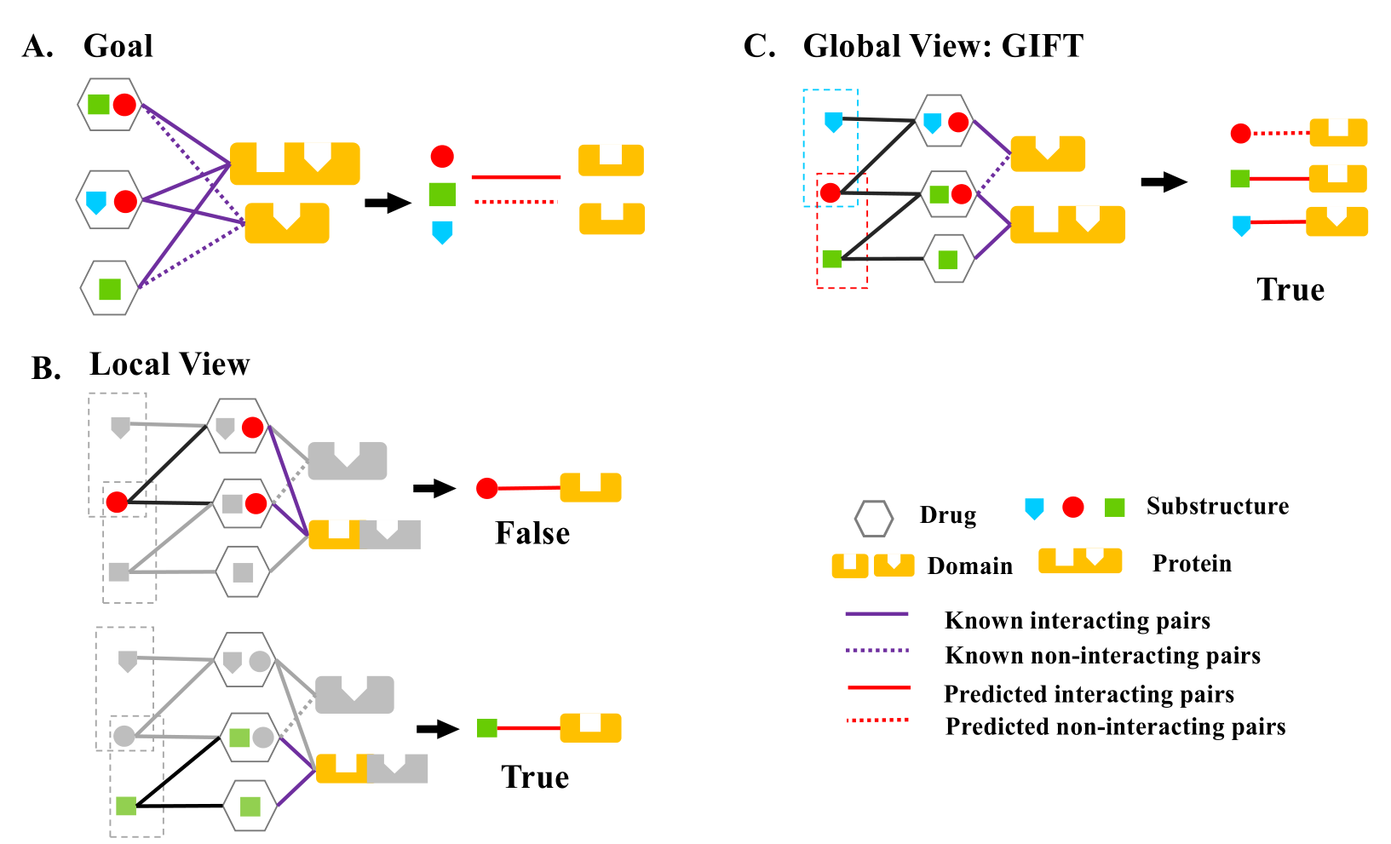
Infer the binding modes
Zu S., et al., Global optimization-based inference of chemogenomic features from drug–target interactions. Bioinformatics. 2015 31 (15): 2523-2529.

Slide 8
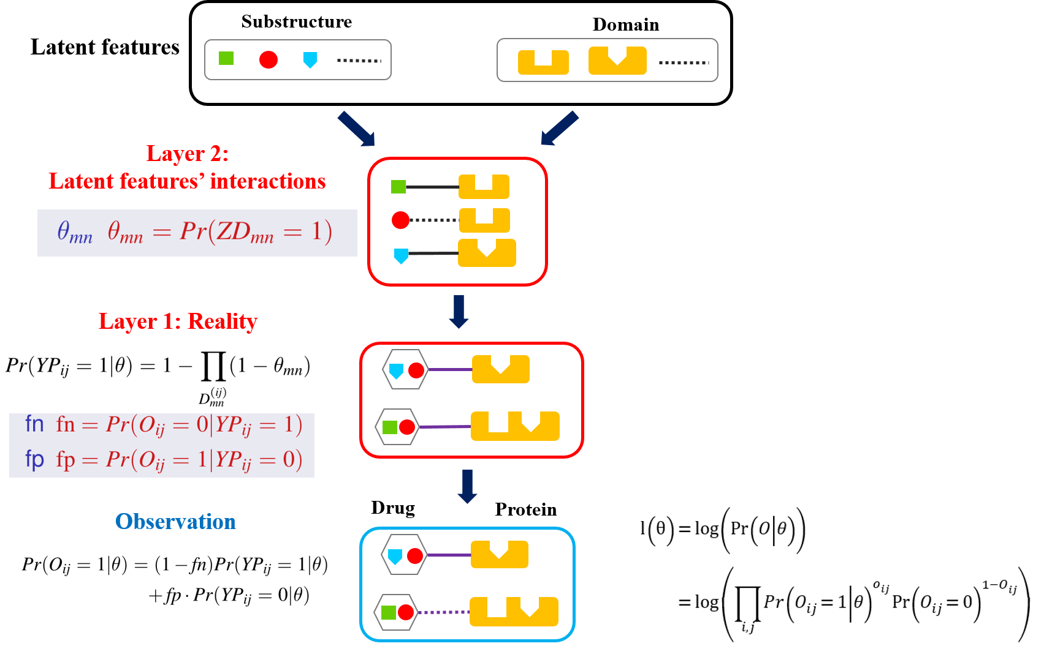
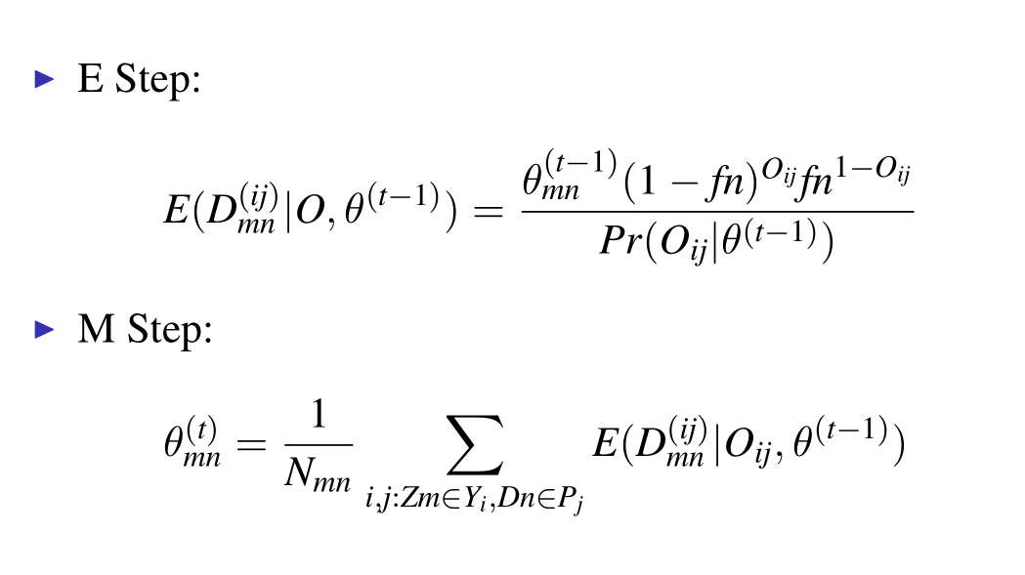
Infer the binding modes
EM Algorithm

Slide 9
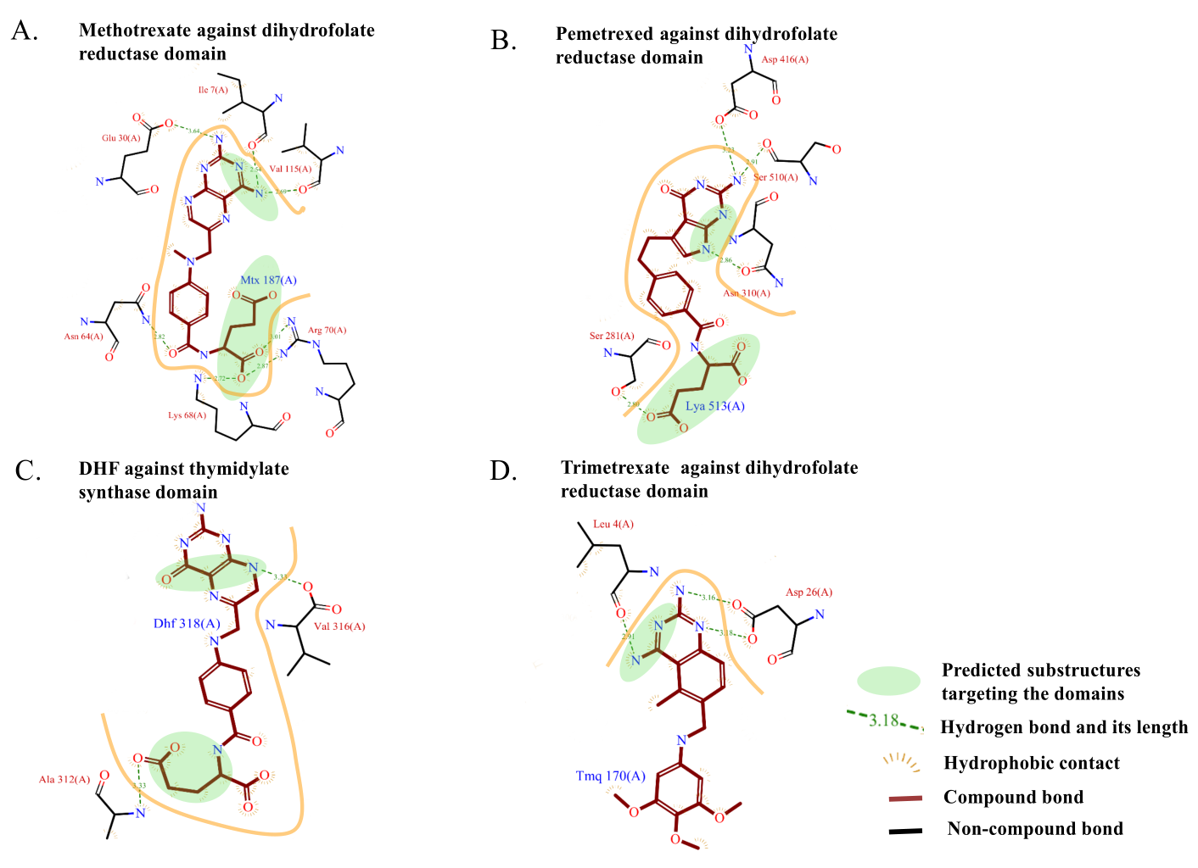
Infer the binding modes
Validated

Slide 10
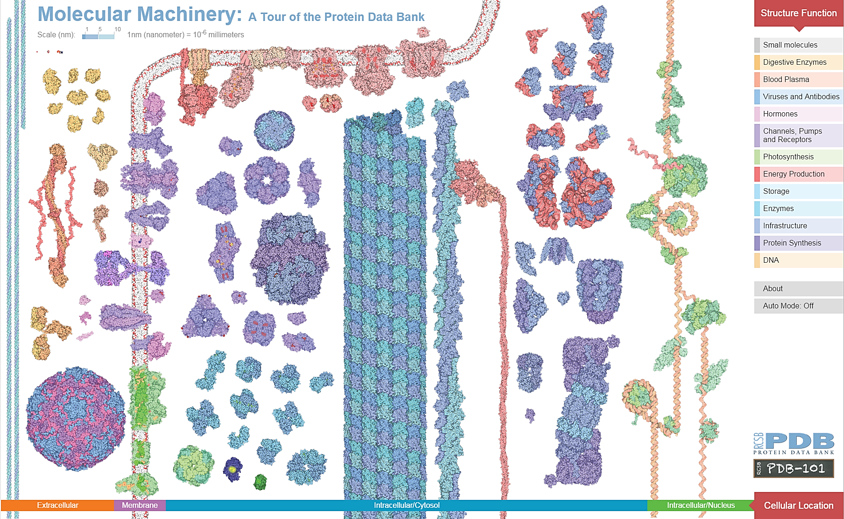
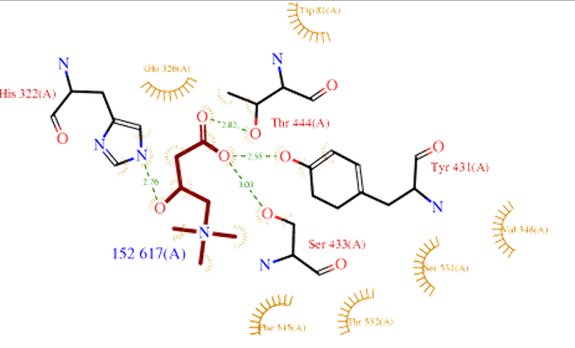
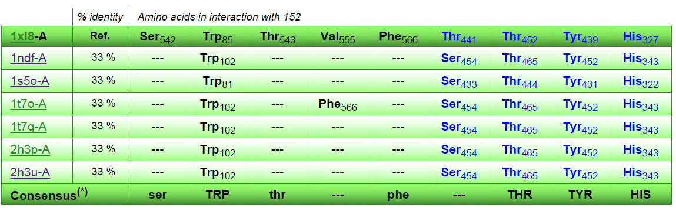
Discussion
Shortage: combinations of fingerprints; only independent assumption
Known binding modes from the PDB database.
9000 distinct compounds among 20,000 compound-protein interactions

Slide 11
Content
Introduction on Compound-Protein Interactions (CPIs)
Prediction on CPIs from Statistical Learning.
Inference on the latent features from CPIs by EM algorithm
Quantitative prediction on CPIs by multi-task learning
Graph partition based prediction on CPIs
Application
Predicting RIP3 inhibitors
Ginkgolide’s bioactivity study
Summary

Slide 12
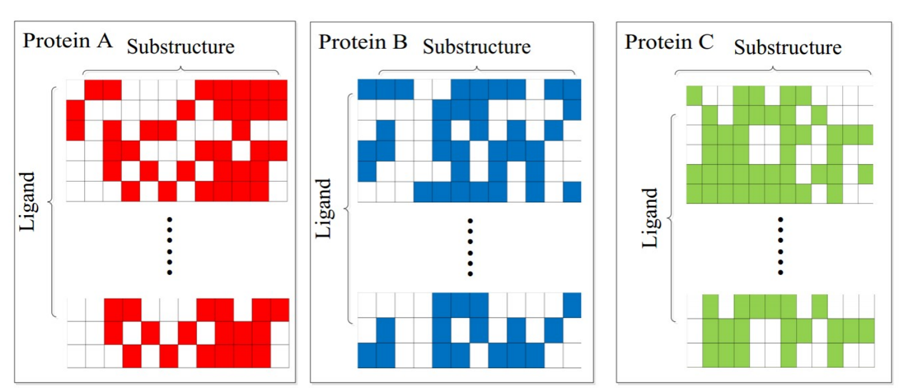
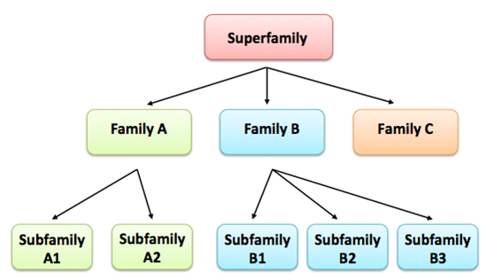
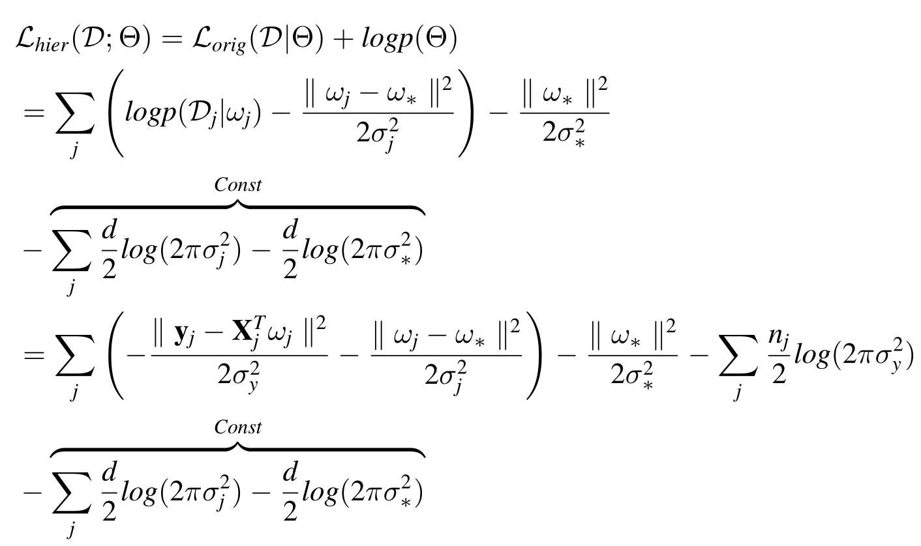
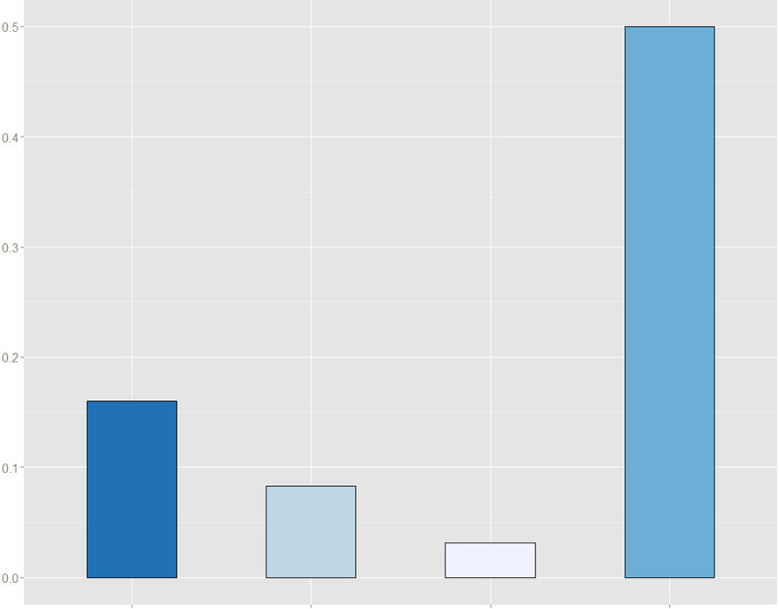
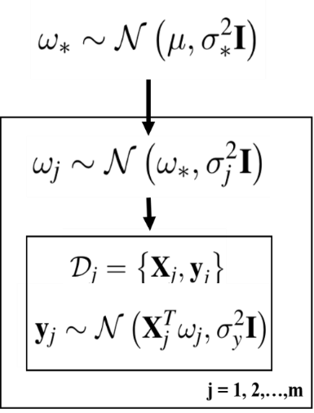
MultiQSAR: Quantitative prediction by multi-task
Comparison with single-task model
Hierarchical Bayesian Model
Log of Joint Probability
Chemoinformatics
Sample Number: 50
About 50% improvement
MSE Reduction
Sample Number: 1000
Less than 10% improvement
Peptide GPCR family

Slide 13
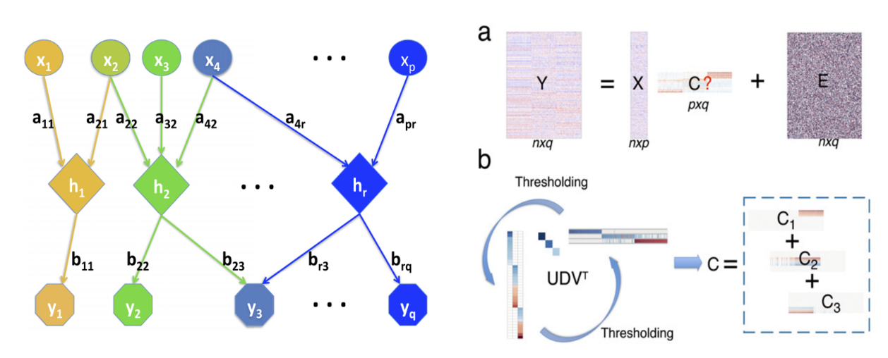
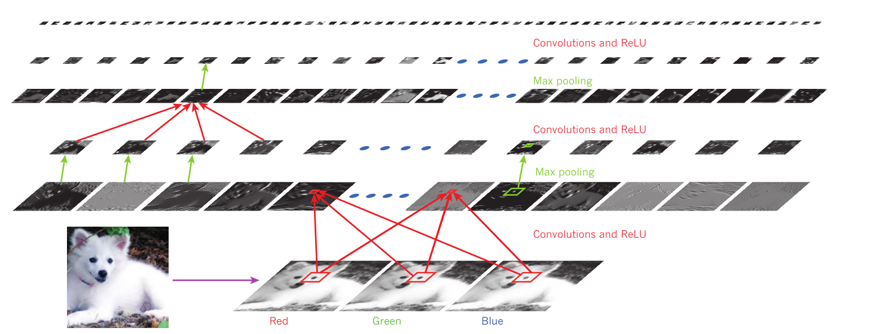
Discussion
Structure Learning
Deep representation
Fingerprints
Combinations of fingerprints
Different proteins
Combinations of fingerprints
Combinations of fingerprints
Ma, X., et al., Learning regulatory programs by threshold SVD regression. PNAS, 2014, 111:15675
LeCun,Y., et al., Deep Learning. Nature, 2015, 521,436-444

Slide 14
Content
Introduction on Compound-Protein Interactions (CPIs)
Prediction on CPIs from Statistical Learning.
Inference on the latent features from CPIs by EM algorithm
Quantitative prediction on CPIs by multi-task learning
Graph partition based prediction on CPIs
Application
Predicting RIP3 inhibitors
Ginkgolide’s bioactivity study
Summary

Slide 15
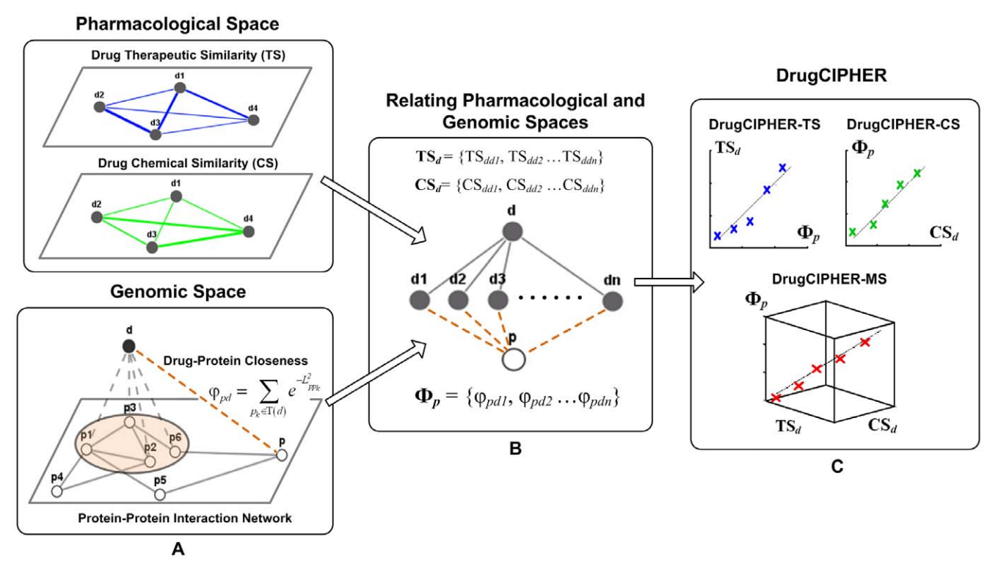
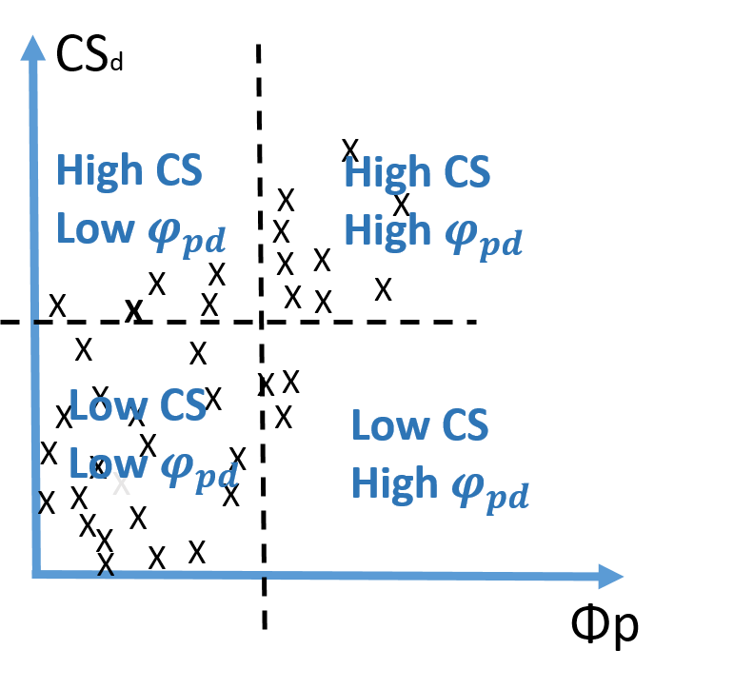
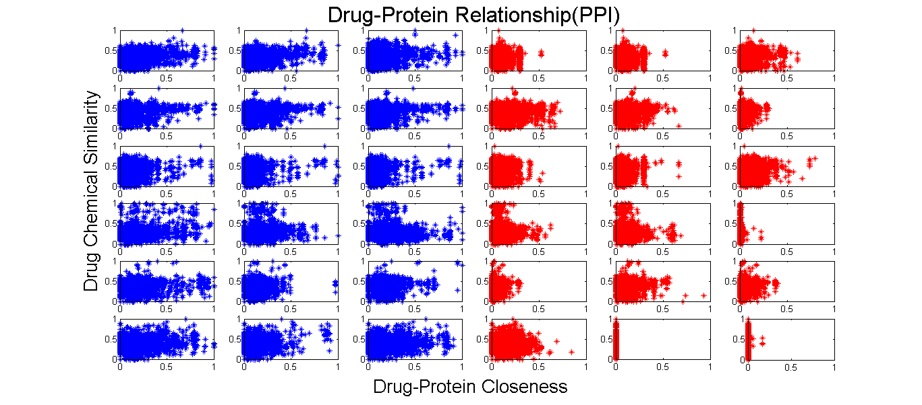
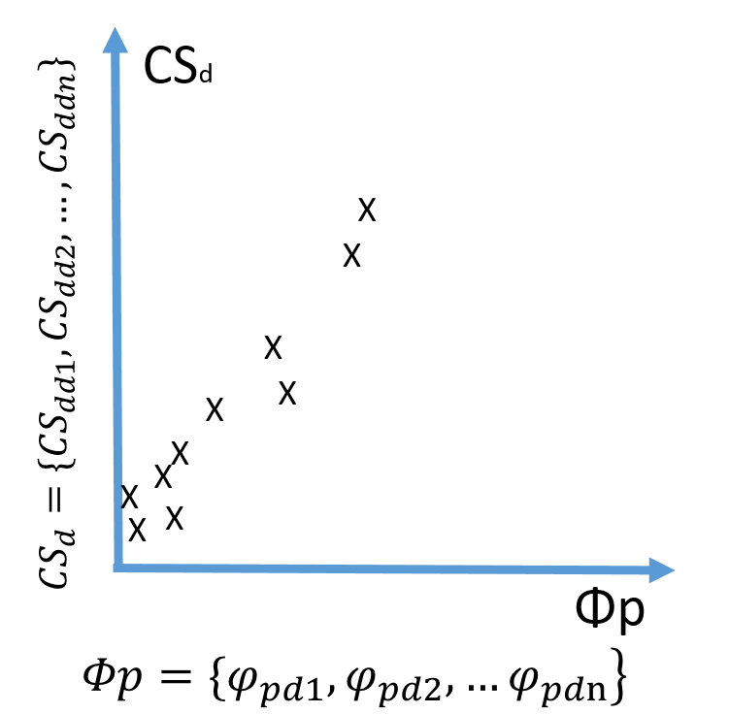
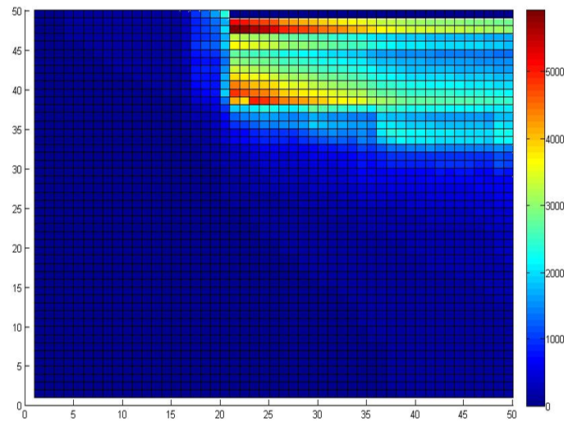
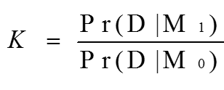
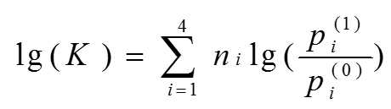
Graph Partition-based Prediction
Real Data
Assumption
Graph Partition
Bayer Factor:
Positive Samples
Negative Samples

Slide 16
Discussion
Integration of multiple similarities
Fisher’s method with dependence correction
Similarity Network
Wu, J., et al., Integrating multiple genomic data to predict disease-causing nonsynonymous single nucleotide variants in exome sequencing studies, PLoS Genetics, 2014,10(3): e1004237.

Slide 17
Content
Introduction on Compound-Protein Interactions (CPIs)
Prediction on CPIs from Statistical Learning.
Inference on the latent features from CPIs by EM algorithm
Quantitative prediction on CPIs by multi-task learning
Graph partition based prediction on CPIs (together with Xin Wang)
Application
Predicting RIP3 inhibitors (together with Qingyang Ding)
*Ginkgolide’s bioactivity study (together with Jianzhou Zhou)
Summary

Slide 18
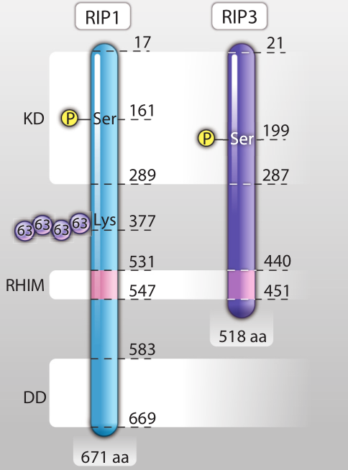
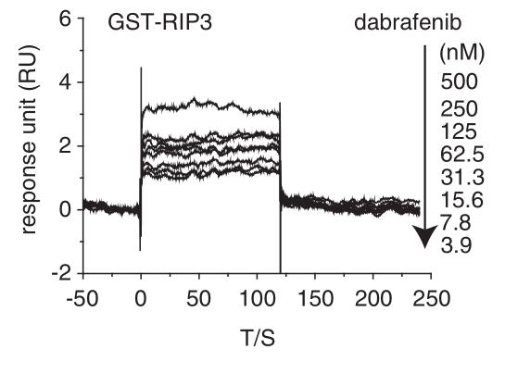
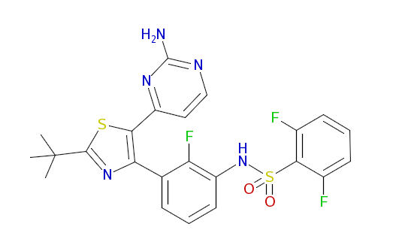
Application: Predicting RIP3 inhibitors.
Essential for necroptosis, a programmed cell death process in response to death-inducing TNF-alpha family members.
Few compounds against it.
Dabrafenib
Zhuang, D.W., et al., RIP3, an Energy Metabolism Regulator That Switches TNF-Induced Cell Death from Apoptosis to Necrosis. Science, 2009. 10(1126): p. 325-332.
Li J-X., et al., The B-Raf V600E inhibitor dabrafenib selectively inhibits RIP3 and alleviates acetaminophen-induced liver injury. Cell Death and Disease (2014) 5, e1278

Slide 19
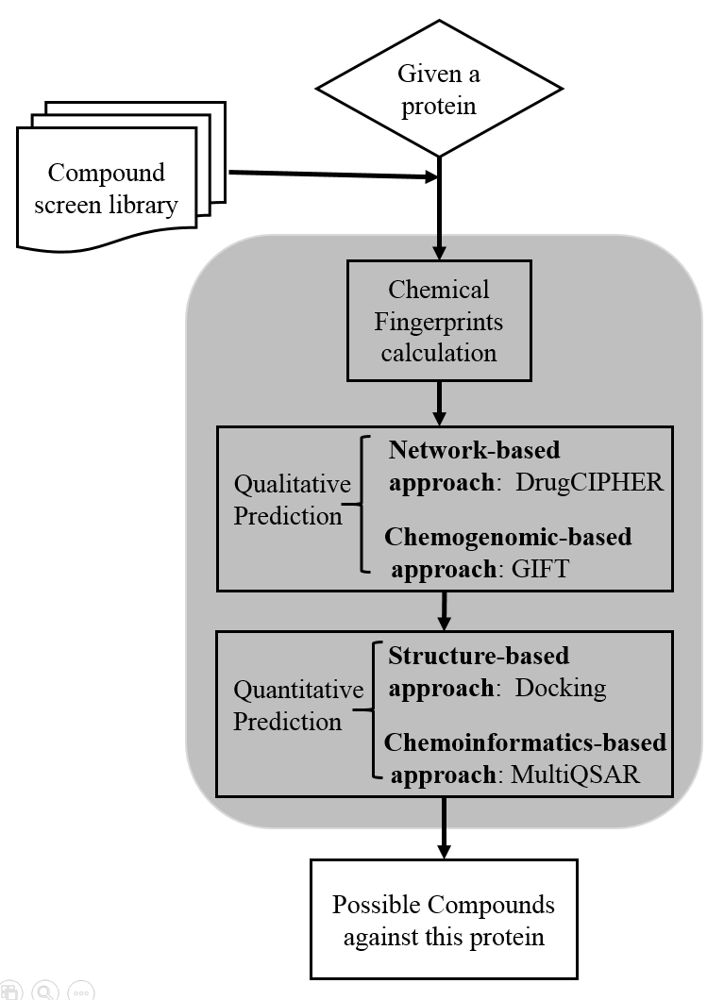
Our Computational Procedure
RIP3
HerbBioMap: 4000
DrugBank: 6800
ChEMBL: 149384
HerbBioMap: 2
DrugBank: 2
ChEMBL: 29

Slide 20
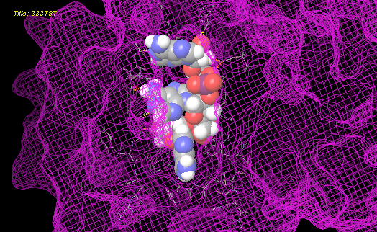
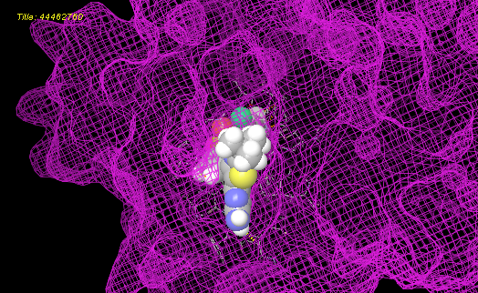
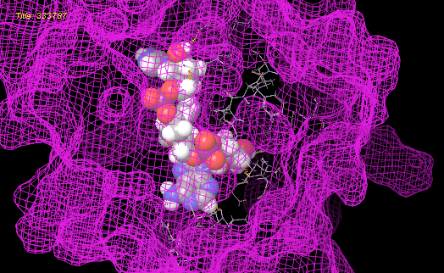
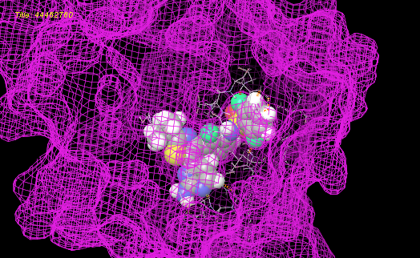
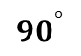
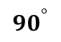
Results
Tri-Co
Positive Control: dabrafenib
$${90}^{°}$$
$${90}^{°}$$

Slide 21

Summary
GIFT, MultiQSAR
Deep representation
Graph Partition
Decipher the CPIs in PDB

Slide 22
Thanks for your listening.
Thanks for Prof. Shao Li’s instruction.
Thanks Xin Wang, Qingyang Ding, and Jianzhou Zhou for the cooperation.
Thanks for Prof. Ting Chen’s many advices on the GIFT project.
Thanks Dr. Jiexing Wu, Prof. Rui Jiang, and Prof. Jun S. Liu’s for the discussion on MultiQSAR project.
Thanks for Prof. Wing Hong Wong’s suggestions on the representation learning.

